Slide 1

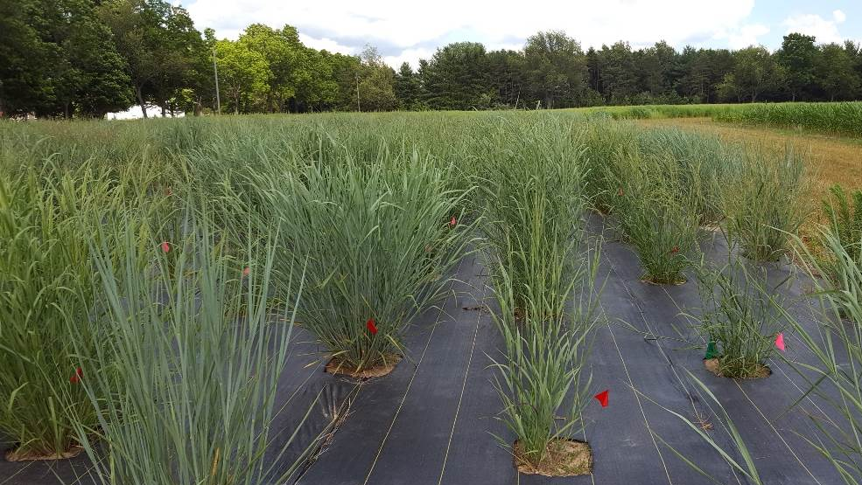

Genetics of Genotype-By-Environment Interactions in the Switchgrass Diversity Panel
Alice MacQueen
BER Plant Genomic Science Workshop
2020-01-13

Slide 2
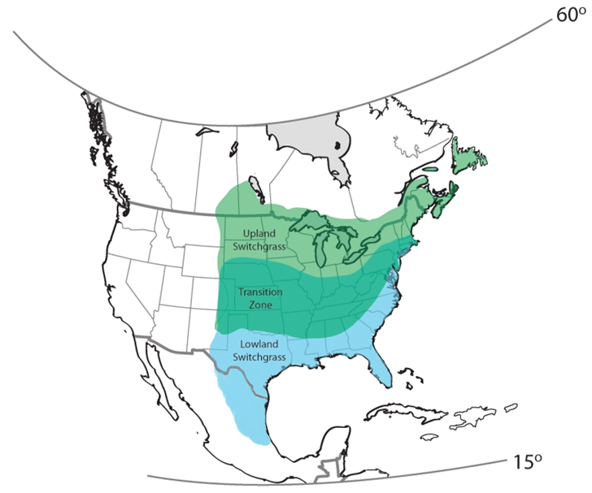
Switchgrass is the model herbaceous bioenergy crop.
Native to North America
Widespread distribution and wide environmental adaptation
Productive on marginal lands
High yielding (7-10 tons dry matter per acre)
If grown on ~5% of land in a 25 mile area, could supply a bioenergy plant 24/7/365
~8 USDA Cold Hardiness Zones
~60 inch variation in Annual Precipitation
Notes:
Typical bioenergy/cellulosic ethanol plant produces 50-million-gallons of ethanol per year
~8 USDA Cold Hardiness Zones
>60 inches of Annual Precipitation

Slide 3
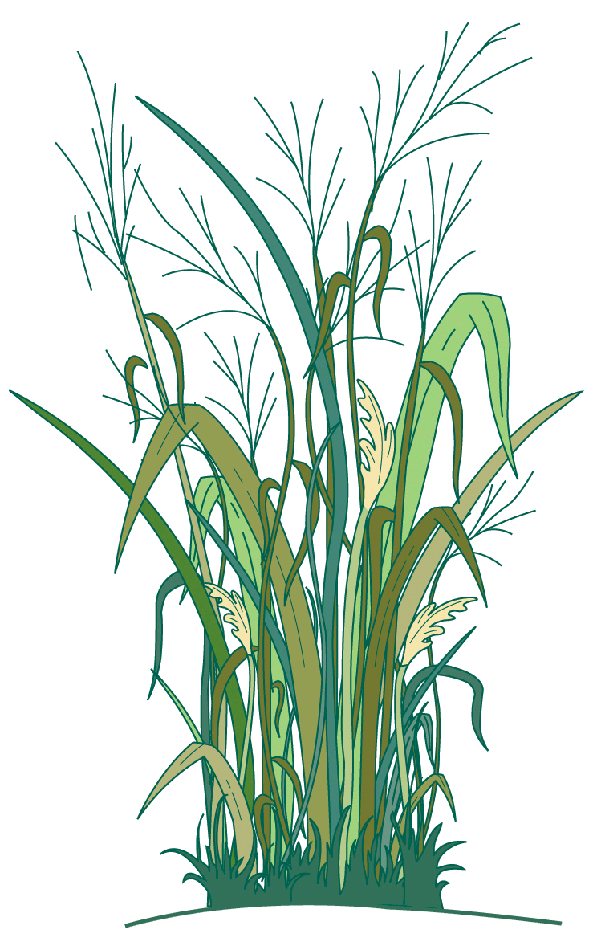
Switchgrass is the model herbaceous bioenergy crop.
Is switchgrass locally adapted to climatic gradients? If so, at what spatial scales?
What are the mechanisms, traits, and genes important for current or future adaptation to climate?
How important are genetic tradeoffs in driving patterns of climate adaptation?

Slide 4
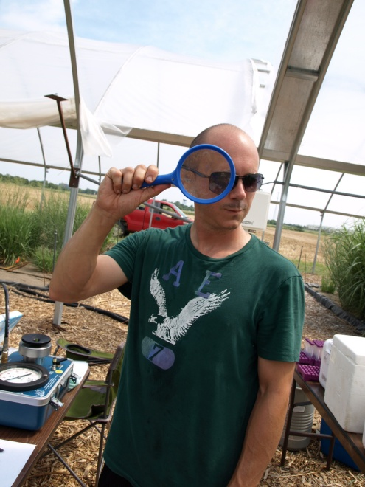





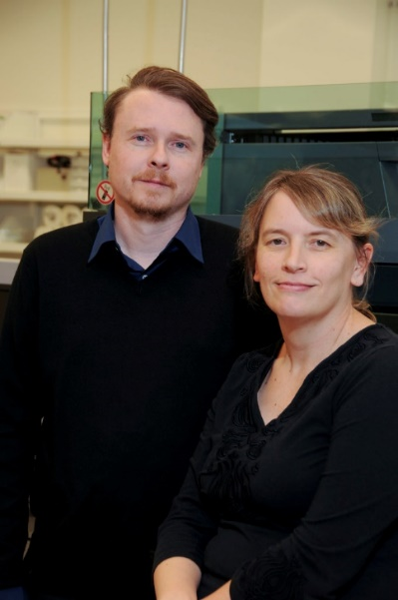





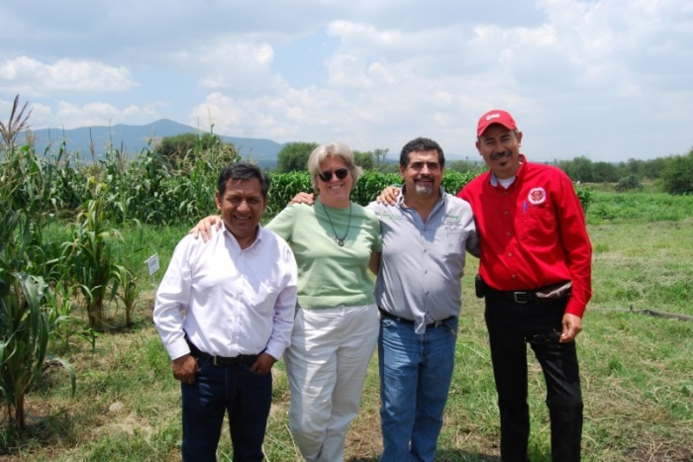

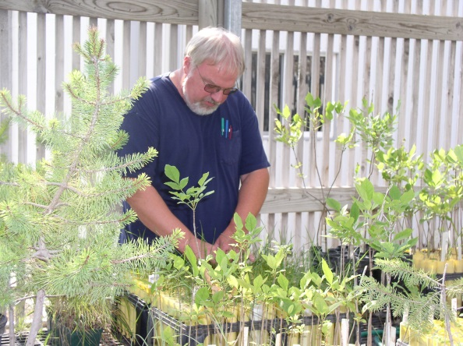



Slide 5
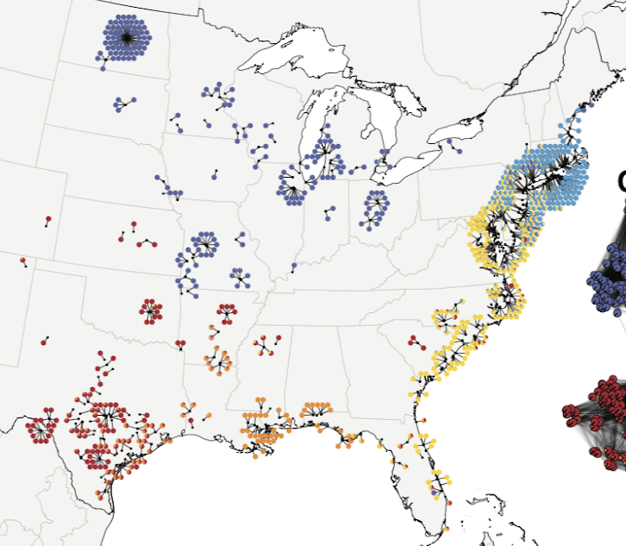
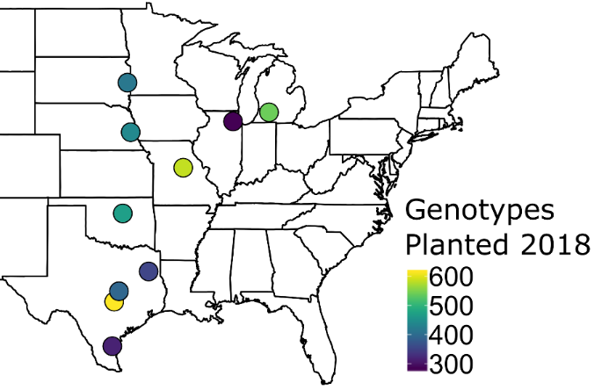
The switchgrass diversity panel was planted in ten common gardens to study adaptation:
Diversity Panel
~700 plants, ~40 million SNPs @ ~45x coverage
Common Gardens
10 U.S. Sites, 17° latitude
Collaborative and community building effort – including involvement of DOE JGI, DOE Bioenergy Centers, CIMMYT, Ladybird Johnson Wildflower Center and many others…..

Slide 6
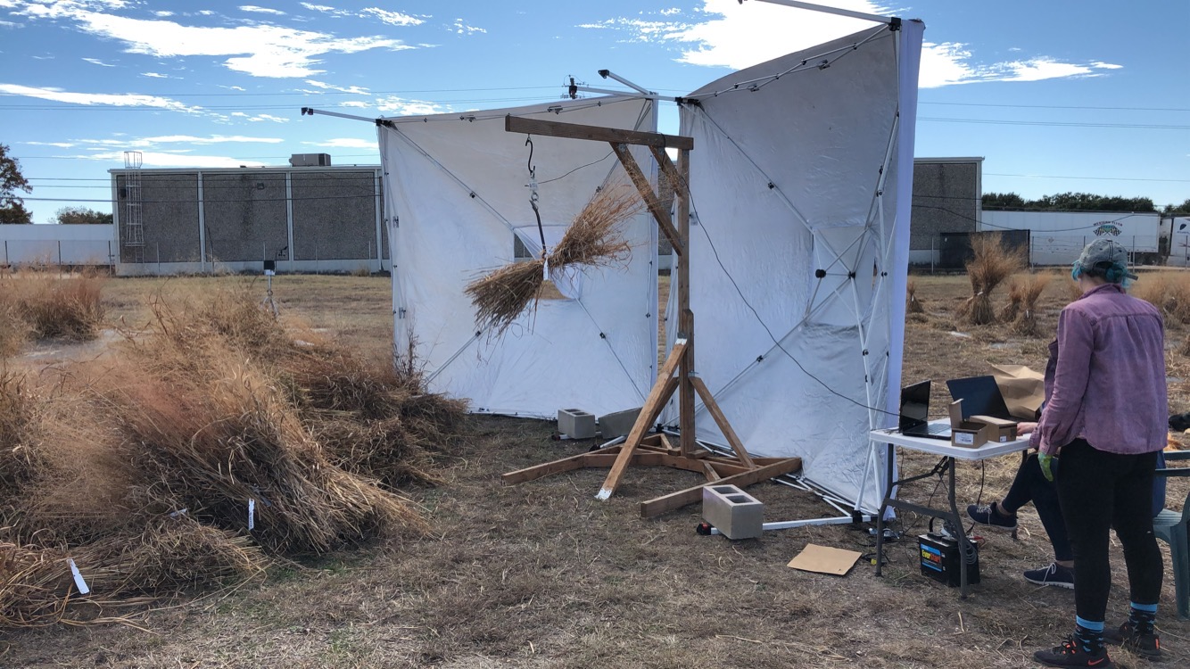
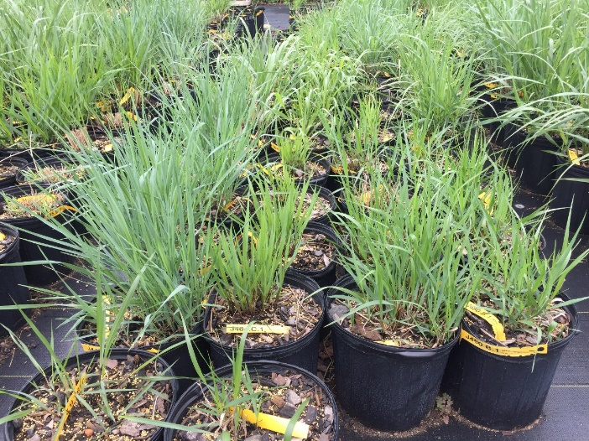
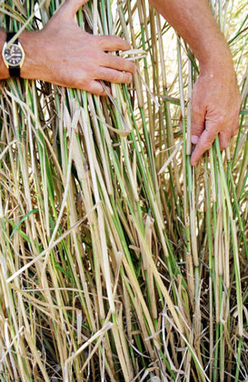
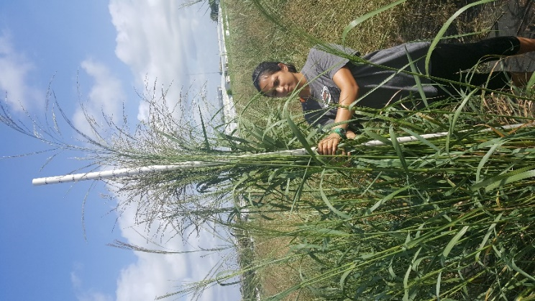
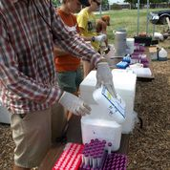
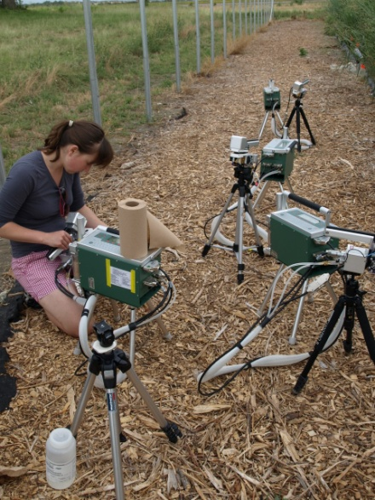

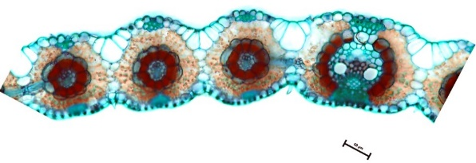
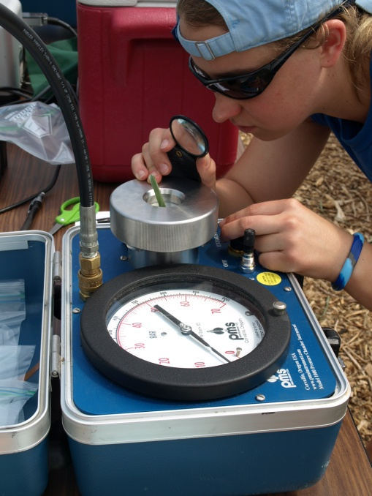
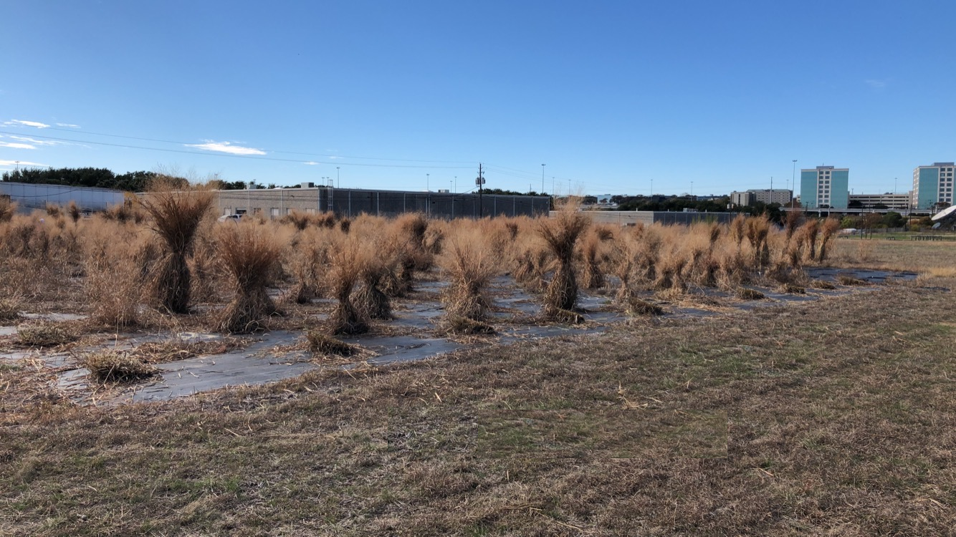

Slide 7
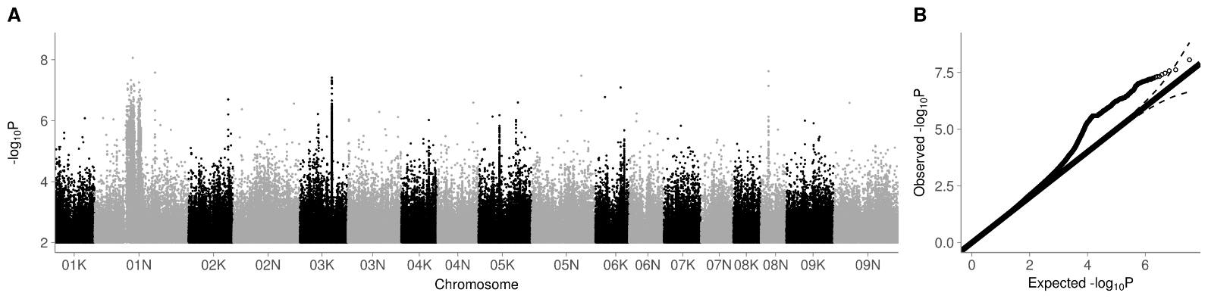
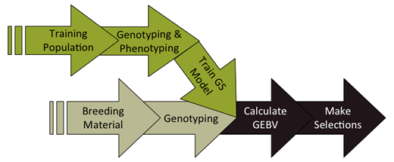
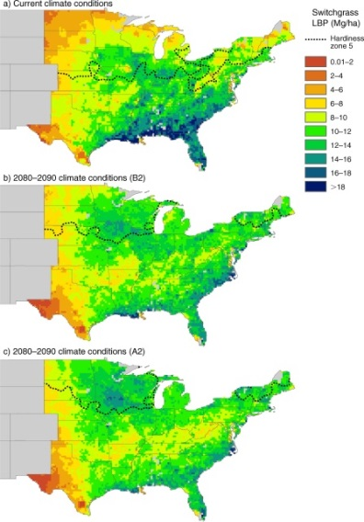
Association & Population Genomic Studies
Genomic Selection & Breeding
Climate Niche Characterization
Agronomic modeling

Slide 8
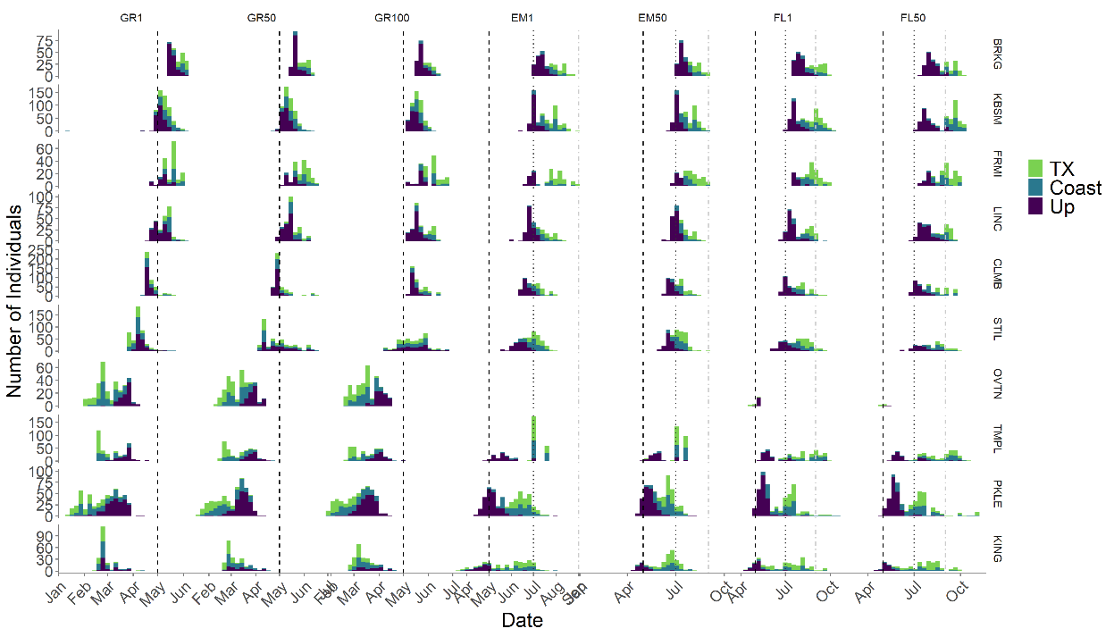
2019 Diversity Panel Data
Notes:
This will be another simplified figure with better axis label sizes

Slide 9
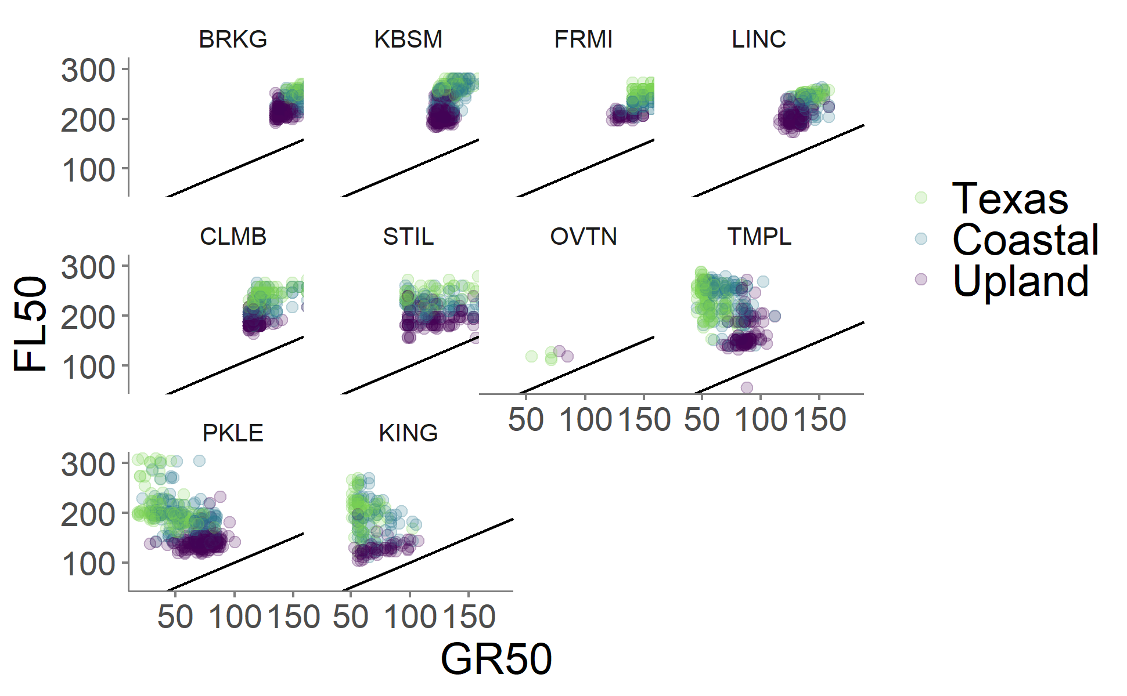
GxE across the common gardens
Northern germplasm grown in the south: Photoperiod sensitivity leading to early flowering and low biomass
Southern germplasm grown in the north: Lack of freezing tolerance and winter survival
Germplasm
Notes:
This will be another simplified figure with better axis label sizes

Slide 10
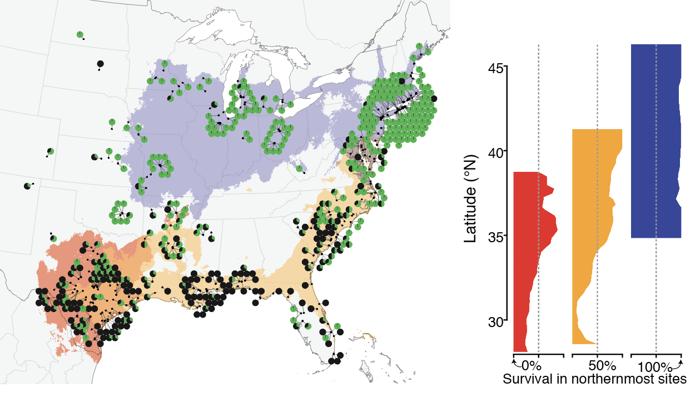
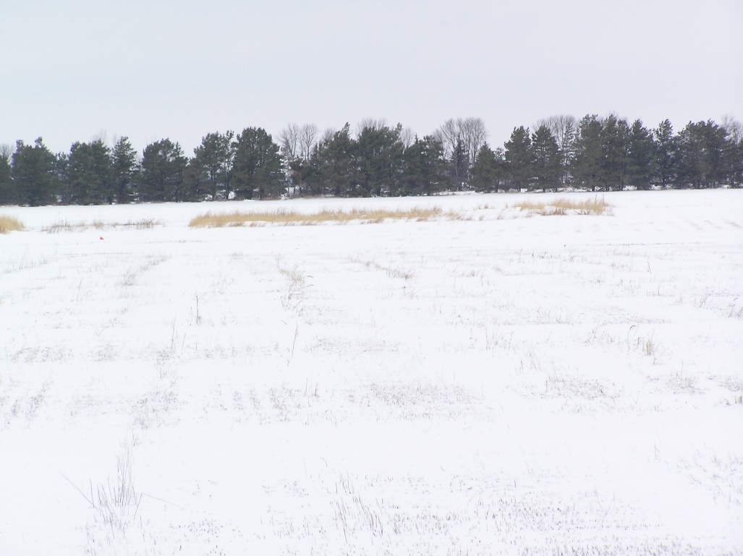
GxE in winter survival
Winter 2018 was cold and we observed considerable winter kill in the north
Geographic distribution of northern winter kill across germplasm
Brooking SD, 11 degrees F on April 5th

Slide 11
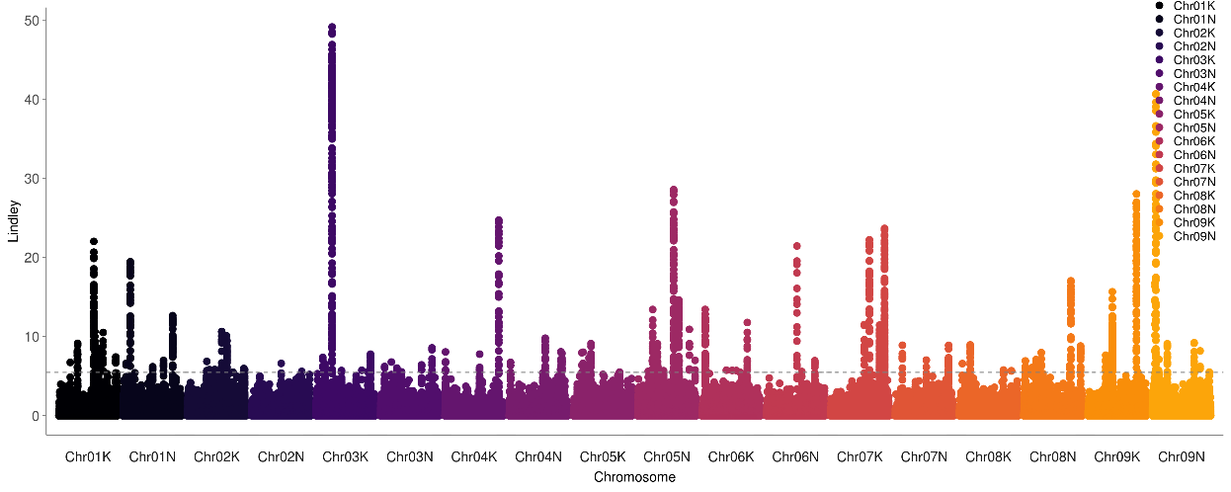
GxE in winter survival
Genetic associations for winter survival at four northern sites

Slide 12
GxE in winter survival
Genetic associations for winter survival in the northern sites
Varying | Genes | For | FRZ | TOL

Slide 13
GxE in flowering time
More varied relationship between plant greenup and flowering at southern sites than at northern sites
Germplasm

Slide 14
Pattern of GxE Effects
“Mashhattan”
Heatmap of shared effects

Slide 15
Pattern of GxE Effects
Table of genes of interest
Effect of one SNP of significant effect

Slide 16
Summary and Outlook
Widespread G x E underlies strong patterns of local adaptation
Conditional effects are common
In terms of breeding, we may be able to select stable QTL or stack together conditionally beneficial QTL to minimize tradeoffs and improve general vigor and climate adaptation.
There is more to come: The diversity panel will expand available genetic variance and opportunities for studying adaptability and GxE
We hope this resource will be useful to the community and welcome collaborative efforts.

Slide 17



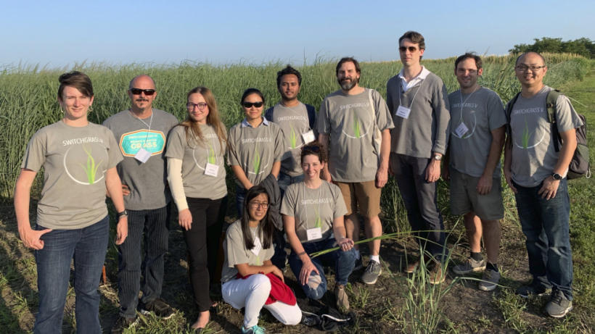
Collaborators
Tom Juenger (UT Austin)
David Lowry (Michigan State University)
Felix Fritschi (Mizzou)
Phil Fay (USDA-ARS, Temple TX)
Jason Bonnette (UT Austin)
Laura Bartley (University of Oklahoma)
John Reilly (USDA-PML, Kingsville TX)
Yanqi Wu (OSU, Stillwater OK)
Monty Rouquette (TAMU-Overton, TX)
Rob Mitchell (USDA-ARS, Lincoln NB)
Arvid Boe (SDSU, Brookings SD)
Kyle Turner
Nathan Pfluger
Matt Donoghue
Chris Bourbois
Jonathan Colen
Sam Lutfy
Marissa Van Damme
Quinn Hiers
Paige Overton
John Row
Joey Budi
Logan Simon
Jeremy Schmutz (JGI/HudsonAlpha)
Jerry Jenkins (HudsonAlpha)
Avinash Sreedasyam (HudsonAlpha)
Sujan Mamidi (HudsonAlpha)
John Lovell (HudsonAlpha)
Shiangqiang Shu (LBL)
Dan Rokhsar (DOE JGI)
Kerrie Barry (DOE JGI)
Funding
DOE Sustainability
JGI CSP
NSF PGRP
DOE Arpa-e

Slide 18
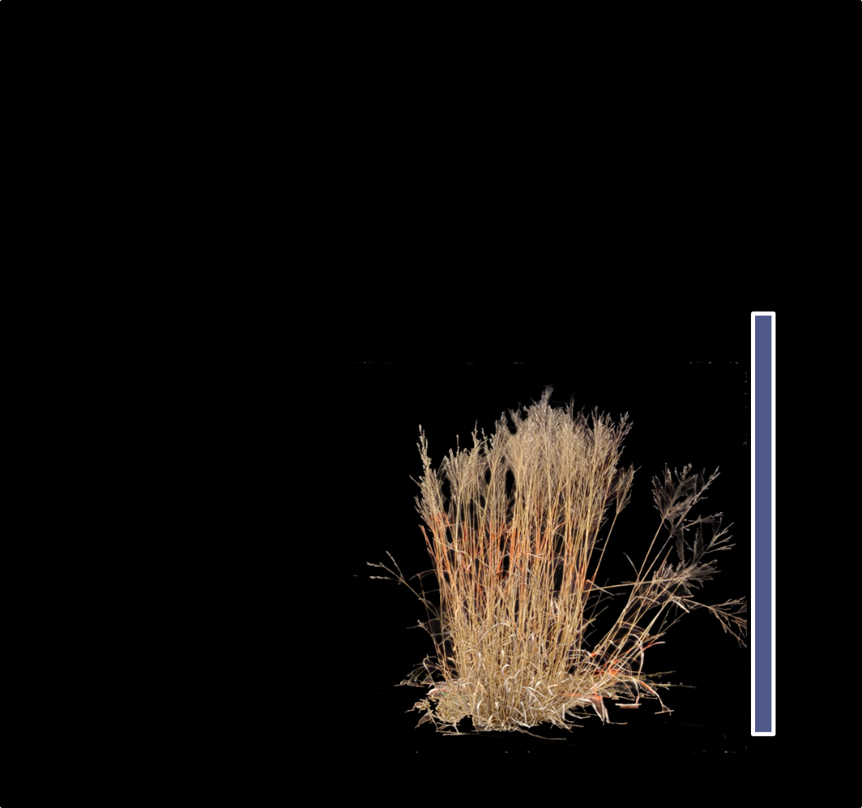
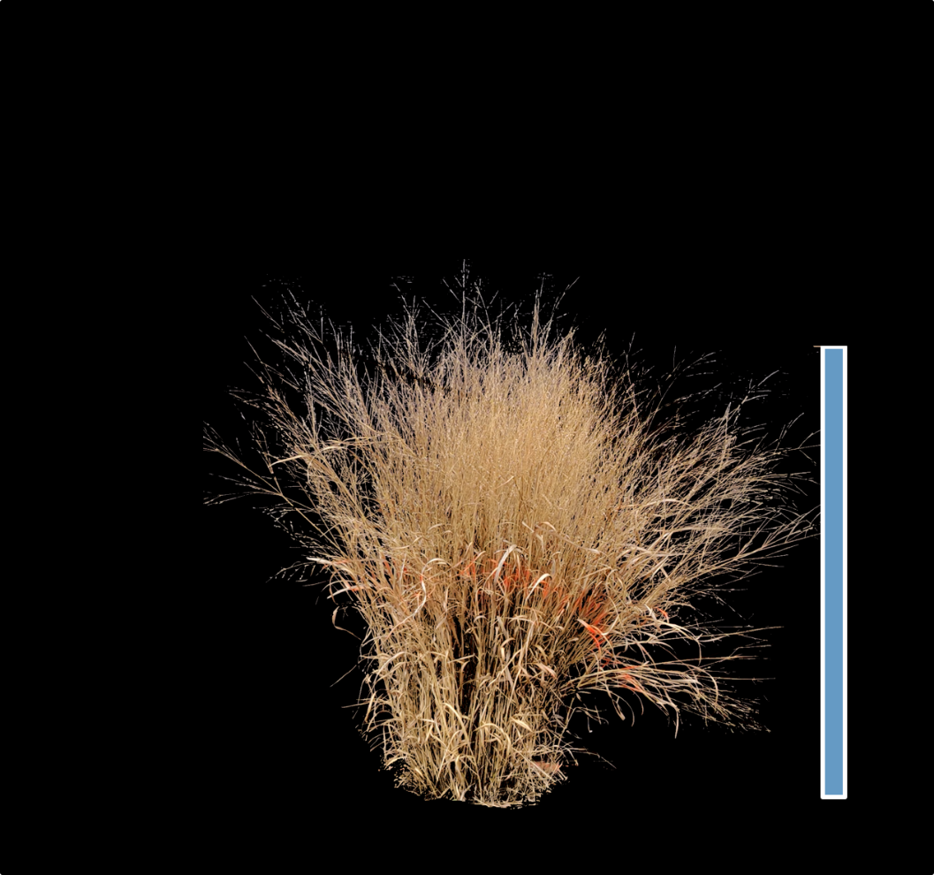
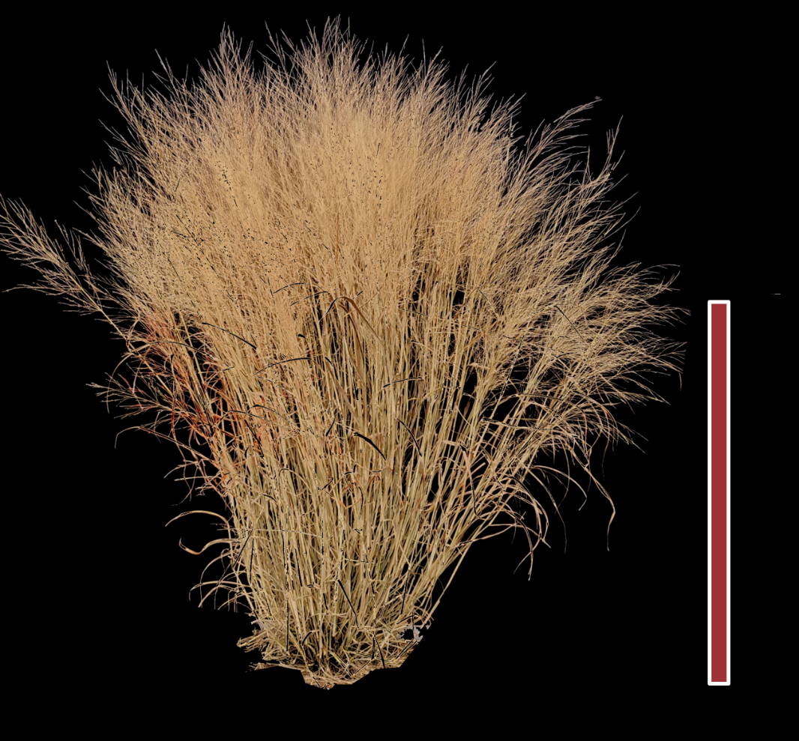
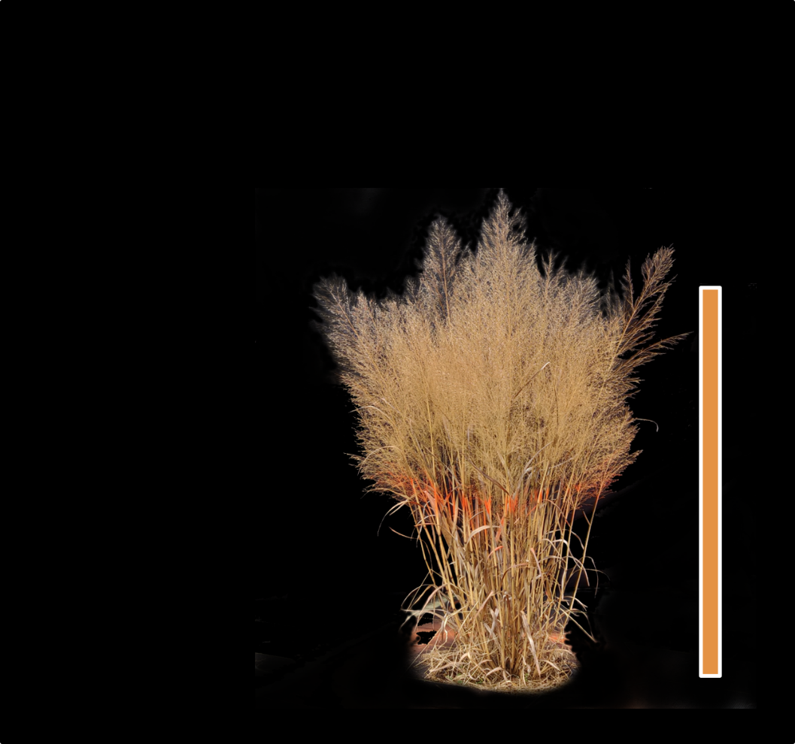
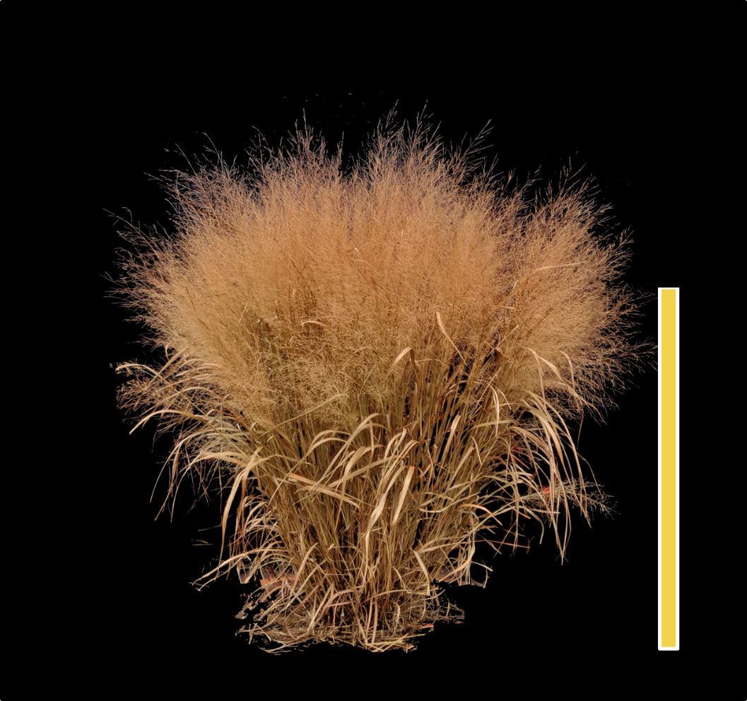
Population Structure and Demographic History

